Slide 1
Resource Conflict and Control

Slide 2
Resources and Conflict
Countries rich in minerals are often marred by corruption, authoritarian repression, militarization, and civil war.
Rebel groups, governments and mining companies exploit mineral resources, fueling civil and interstate conflict as players vie for control over riches.

Slide 3
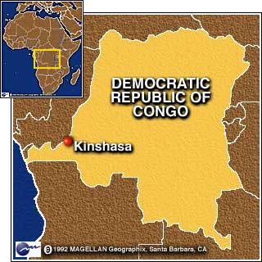

Smuggled diamonds have been used to fund armed rebel groups involved in civil wars in African states such as Sierra Leone, Angola and the Democratic Republic of the Congo.

Slide 4
The “resource curse”
Countries rich in resources (such as Congo) have been affected by "resource curse“
Phenomenon where countries that are rich in resources have worse economic development than countries that have fewer resources
Greater wealth of resources = greater levels of corruption
→ political instability
→ no balanced and sustained development
Notes:
whoever controls the assets (mainly the political leaders, and the government in Congo) can use them to their own benefit. These resources generate wealth for these people which they use to stay in power "…either through legal means, or coercive ones (e.g. funding militias)".^{[16]}

Slide 5
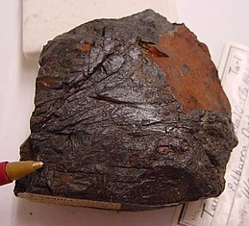
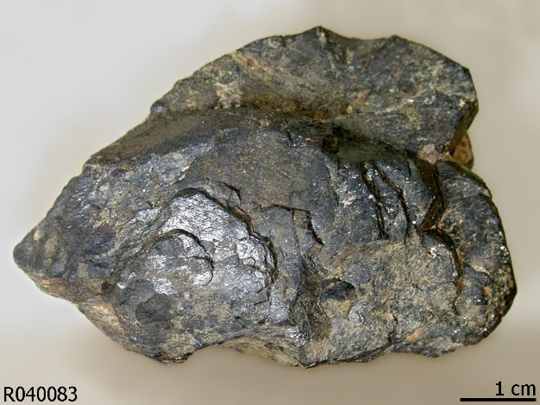
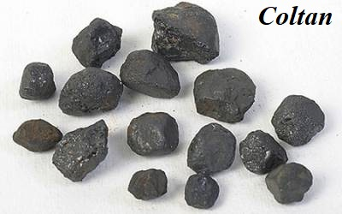
Example: Coltan Mining
Columbite-tantalite — "coltan" for short — is a dull metallic ore found in major quantities in the eastern areas of Congo.
Coltan becomes metallic tantalum, a heat-resistant powder that can hold a high electrical charge.
This is a vital element in creating capacitors, the electronic elements that control current flow inside miniature circuit boards.

Slide 6
And this affects me how?
Tantalum capacitors are used in almost all cell phones, laptops, pagers and many other electronics.
The recent technology boom caused the price of coltan to skyrocket to as much as $400 a kilogram at one point, as companies such as Nokia and Sony struggled to meet demand.

Slide 7
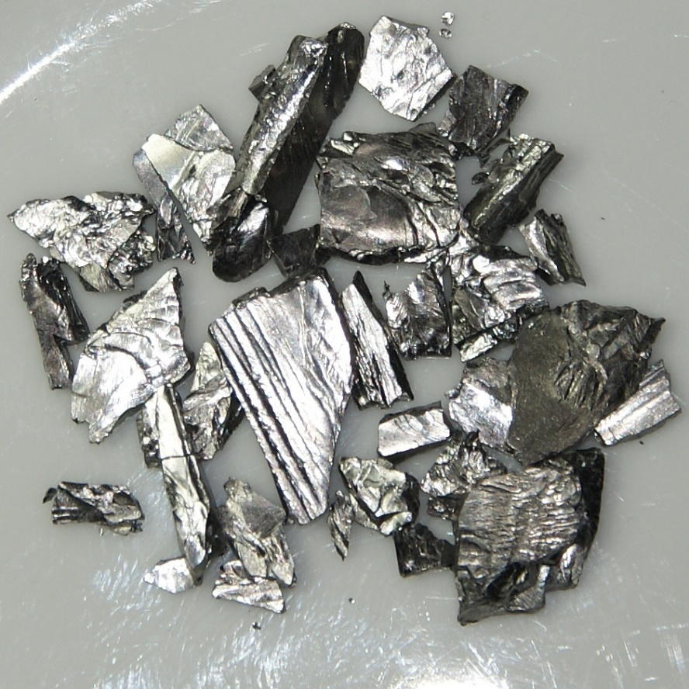

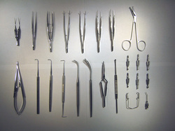



Tantalum and our Modern Lifestyle
Notes:
Used to make surgical tools because it causes no immune response

Slide 8
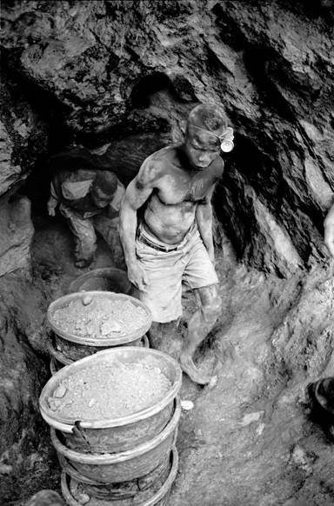
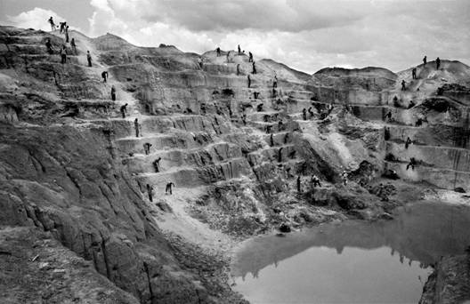
Coltan Mining Methods
Notes:
As coltan because more crucial to tech products, warlords and armies in the eastern Congo converted artisanal mining operations…into slave labor regimes to earn to finance their militias
Approximately 71% of global tantalum supply in 2008 was newly mined, 20% was from recycling, and the remainder was from tin slag and inventory.

Slide 9
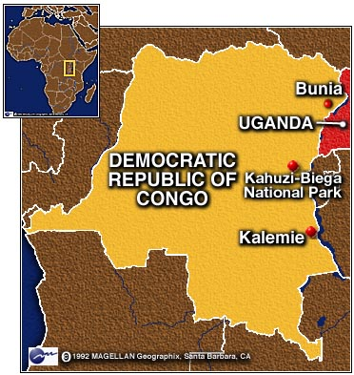

Environmental Consequences
In order to mine for coltan, rebels overran Congo's national parks, clearing out large chunks of the area's lush forests.
Poverty and starvation caused by the war drove miners and rebels to hunt the parks' endangered elephants and gorillas for food.
In Kahuzi Biega National Park, for example, the gorilla population wasbeen cut nearly in half during this time

Slide 10
The Congo – Resource Curse
The international community failed to effectively tackle the link between resource exploitation and conflict in the Congo.
The trade in diamonds and gold are other example of a wider trend of competition for resources and resulting human rights abuses taking place in mineral rich areas throughout the Congo.
The link between conflict and resource exploitation raises broader questions of corporate accountability in the developing world.

Slide 11
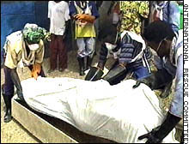

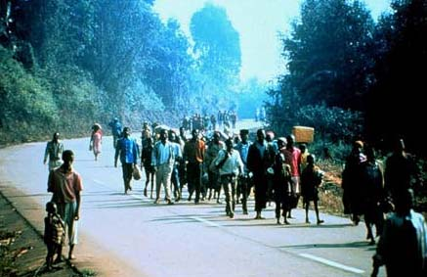
Aid group estimates war-related death toll in east Congo at 2 million as a result of a two year war over these resources
June 21, 2000
CNN.com

Slide 12
Cartels/Syndicates
A cartel is a group of governments, companies or individuals who band together to control the production and hence the price of a commodity.
OPEC - Oil
DeBeers - Diamonds

Slide 13
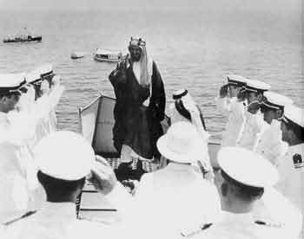
Oil in the Middle East
May 25, 1908 - British millionaire, William Knox D'Arcy, struck oil in western Persia – first oil discovery in Middle East
Britain negotiated oil contracts with Iran in 1911.
Iranian King with British navy, 1938

Slide 14
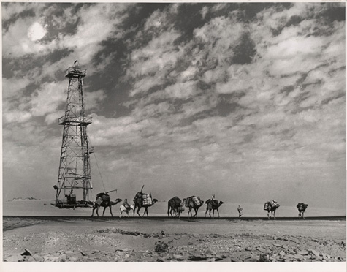
Then the Americans got involved
American oil companies got involved in the 1920’s with Saudi Arabia.
In 1930’s Oil Well #7 in Dammam was the first to turn Saudi Arabia’s fortunes when SoCal geologists got the permission to drill
Notes:
The first 6 wells were dry holes, but #7 produced over 3000 barrels/day

Slide 15
US companies control the market
The 1950s were “boom times” for the international oil companies in the Middle East.
As a result of so much oil being produced there, import quotas were introduced to protect US produced oil.
This resulted in lower oil revenues for Middle Eastern (ME) countries.
The ME countries were not happy.

